Slide 1
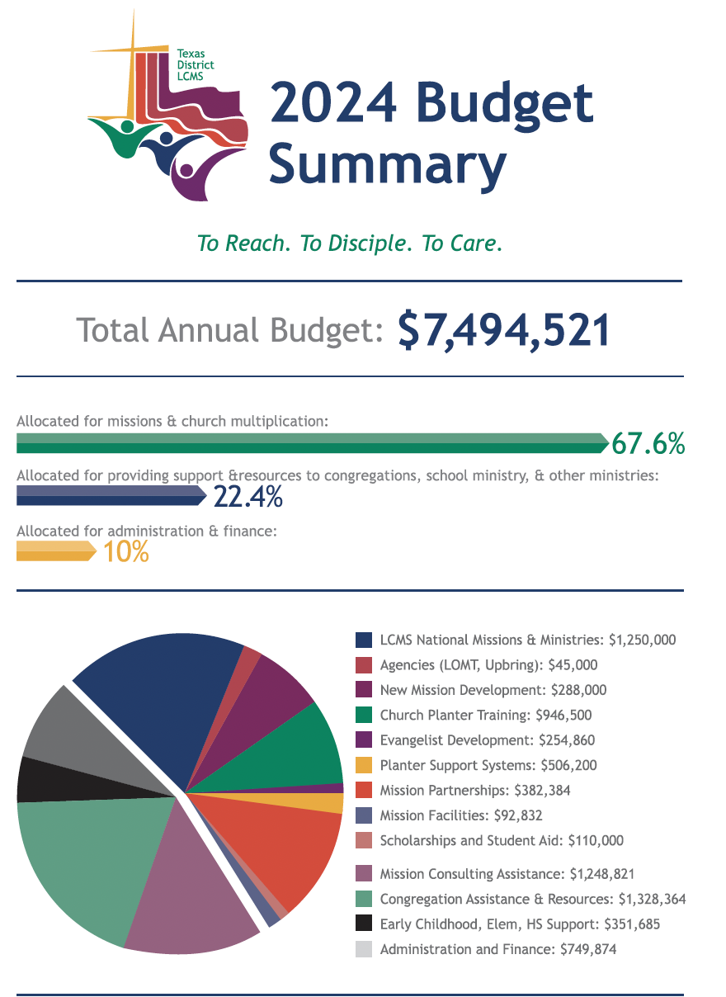
Mission and Stewardship Facts 2024

